Slide 1
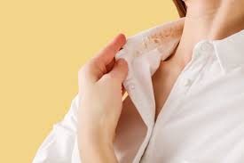
Glamour Shield
Protecting objects from glamour so you don’t
have to!
Glamour Shield is a long-lasting, humidity-resistant setting spray designed to keep makeup flawless all day, even in the toughest conditions. Perfect for those who love beauty and the outdoors, it prevents melting, smudging, and residue buildup.
Notes:
Paste your Slyngshot URL here: https://glamourshield.slyngshot.io/

Slide 2
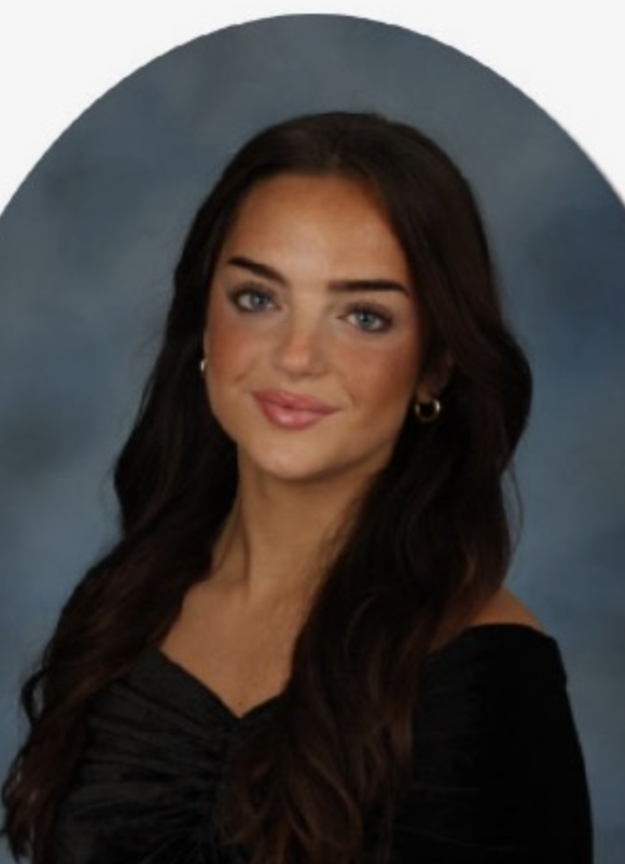
Meet The CEO
I have always loved makeup, tanning products, and all things glamorous, which inspired me to create Glamour Shield—I hope you enjoy it as much as I do.
As a Florida native who loves the outdoors, I know the struggle of makeup melting in humid weather, and this product ensures you stay flawless all day.
Notes:
I am a self tanner and makeup enthusiast so I am interested in solving a common problem that has not been fully solved yet. I have had experiences where in sports I have had to get spray tans and must wear white uniforms at the same time. This has never come out pretty due to the fact that at least some percent of the tan will transfer on to the uniform no matter how long you leave it on for. I am very good at communicating and like to work with people in group settings. I believe that my collaboration efforts can lead me in getting the best inputs on how to execute the marketing of this product. I am a Marketing Major so I believe that I can use the target audience and position my product effectively to gain the most profit for this product. I hope to make other people have a worry-free experience from now on and realize that life is about living and not worrying about where your makeup or fake tanner is.

Slide 3

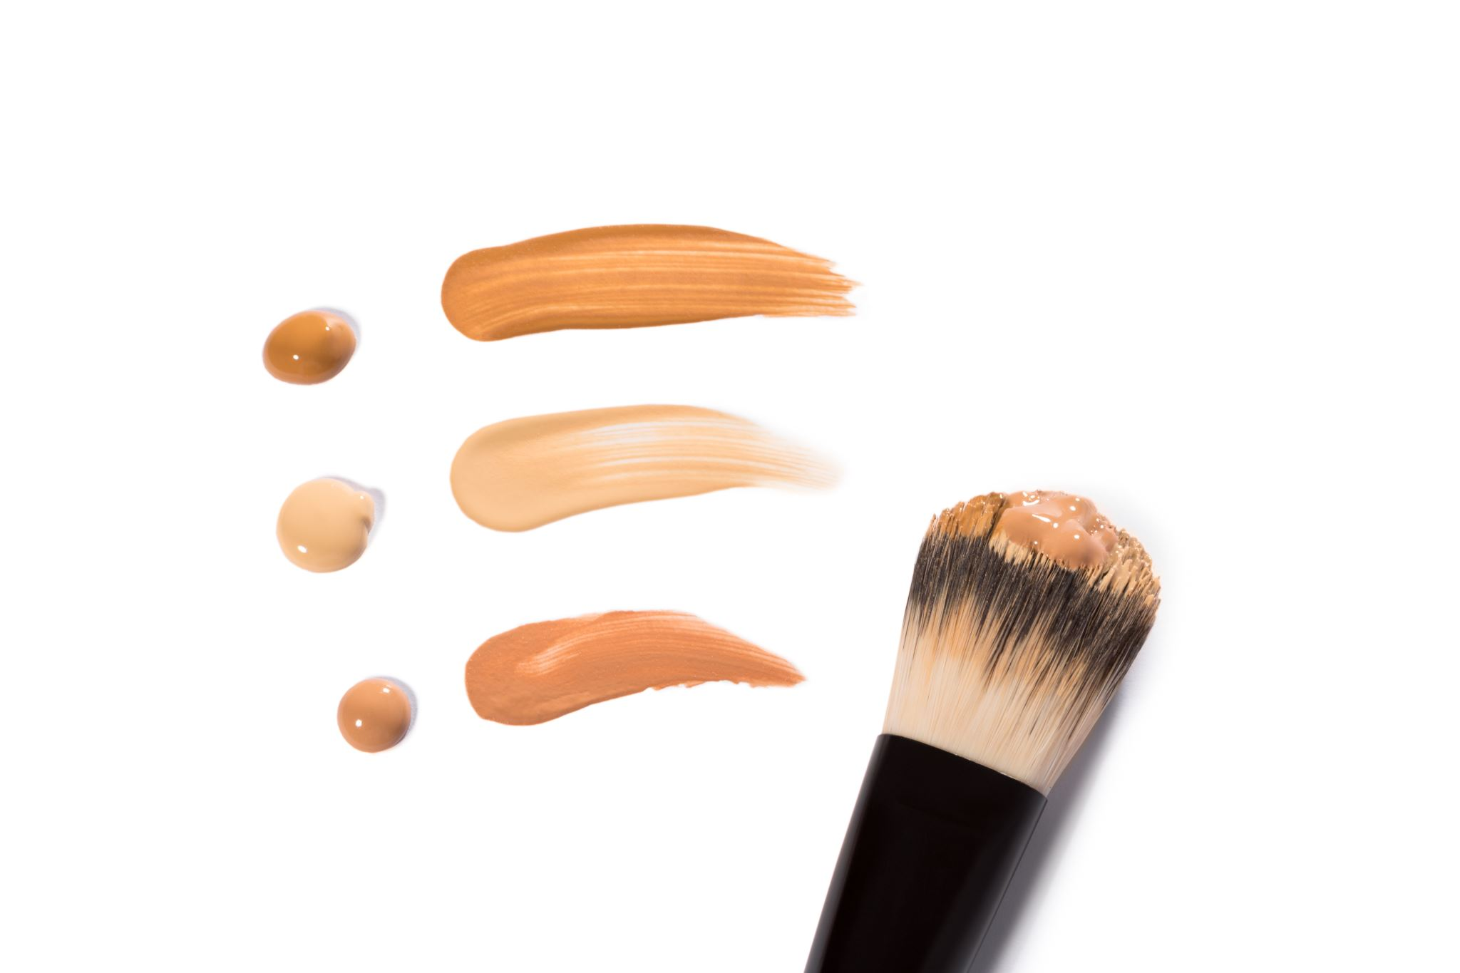
Summary Slide
Our mission is to provide a revolutionary setting spray that shields makeup and fake-tan from transferring onto other surfaces while keeping your look fresh and flawless all day.
We aim to empower individuals to confidently wear their makeup without the worry of smudging, transferring, or fading.
Notes:
Problem: My problem that I am trying to solve is when your makeup gets on
other things when I try to do daily activities like take phone calls, take naps, or
when you put on clothes. This is very aggravating since it ruins other products I
want to enjoy alongside.
• Solution: A lightweight mist/spray that creates a shield against makeup on other
things like your phone screen, clothes, and pillow sheets.
• Total Revenue Projection: $11,226,985

Slide 4
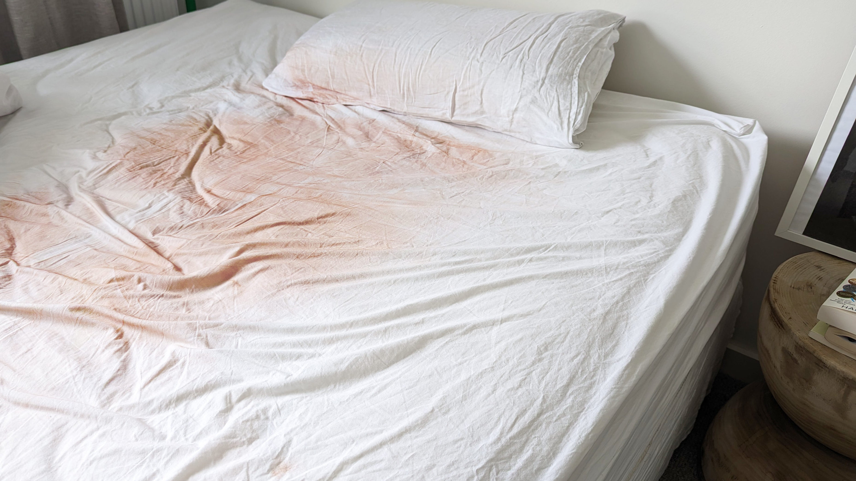



.
The Problem?
Self –tan and makeup transferring on to other valuables of yours can be aggravating and costly.
Hard stains with an even more difficult removal
Can have a detrimental effect on your favorite fabrics.
Uneven wear and smudging.
Notes:
According to a study by Laundryheap, self-tanner is one of the most common causes of stains on white clothing and bedsheets. Many self-tanners contain DHA (dihydroxyacetone), which reacts with fabric fibers, making stains difficult to remove.
Studies on cosmetics show that heat and humidity increase the chances of foundation and bronzer smudging, especially for people with oily skin.
Kim Kardashian once shared how her body makeup transferred onto furniture and clothing, leading to her launching a transfer-resistant body foundation.
Meghan Markle was spotted with foundation transfer on Prince Harry's suit collar at a public event, sparking discussions on makeup staying power.
A woman shared on Reddit that she sat on her white couch after applying self-tanner, leaving brown streaks that wouldn’t come out even after multiple cleaning attempts.
A fake tan enthusiast revealed how her leather car seats turned orange due to self-tanner rubbing off on a hot summer day, requiring professional cleaning.

Slide 5

Solution
A setting spray that uses cutting edge resources and ingredients to keep you glamorous all the time!
Locks in your makeup and fake tanner in to place with no smudges guaranteed
Prevents 100% of any makeup or artificial tan onto any fabrics or surfaces.
Non-clogging and dermatologist approved.
Eco-friendly with biodegradable packaging.
This Photo by Unknown Author is licensed under CC BY-ND
This Photo by Unknown Author is licensed under CC BY-ND
Notes:
Locks in your makeup and fake tanner in to place with no smudges guaranteed
This is achieved through using waterproof ingredients that aren’t susceptible to failing due to humid conditions. Also uses polymer film technology which creates a breathable and lightweight barrier over the products used. This goes in hand in hand with the product being a lightweight mist since this advanced technology makes it possible.
Prevents 100% of any makeup or artificial tan onto any fabrics or surfaces.
As you can see, polymers are a key ingredient for this products success, so it is no surprise that adhesive polymers are used to lock products into place by creating an unbreakable bond between them and the outside world.
A quick drying formula ensures that transfer is a problem no longer since it dries instantly, therefore closing the gap of smudging or rubbing off.
Non-clogging and dermatologist approved.
Incorporating oil-free and non-comedogenic ingredients lets the skin breathe and guards against any acne or breakouts so you can use this product worry-free.
Eco-friendly with biodegradable packaging.
The packaging of this product is used with 95% recyclable materials so that you are not putting the earth at any risk by using our product.
No harmful chemicals, aerosols, or parabens are used which supports our clean beauty initiative. Also uses vegan ingredients and does not test on animals.

Slide 6
Product
Customer buys the product “Glamour Shield” exclusively at Ulta online or in store.
After the customer is done applying their makeup and/or artificial tanner, they must wait no longer than 5 minutes to apply the product.
Do not apply any other products on after application and enjoy your smudge-free experience.
Notes:
Once upon a time … my customer was at a birthday party with a large group of both men and women which included people she knew and people she didn’t know. She was so excited to wear her new white top that she bought for $50 from her favorite store at this function
this happened … my customer was out and about and noticed that her self tanner had transferred onto her white shirt. This is rather embarrassing for her because the marks of self tanner are very visible and there is nothing she can do since she doesn’t have a change of clothes. (inciting incident - what happens that makes your customer experience the problem you are addressing?)
… and this was the result…. Multiple people came up to her to point out the noticeable stain on her shirt causing her shame and embarrassment when she should instead be having fun and not worrying. Also, her new shirt that was on the pricier side is now ruined due to the self tanner transferring on it which is costly and disappointing. (what happens when this problem occurs?)
Then along came our hero … In need for a new self tanner, the customer goes to Ulta and comes across ”Glamour Shield” while strolling the aisles. After reading its solution and purpose she realizes the problem wasn’t her self tanner it was the lack of a “Glamour Shield” on her makeup desk. She then leaves Ulta satisfied with her purchase of this product.(describe how they find and acquire your solution)
… who helped by …The “Glamour Shield” was then applied the next she used fake tanner and she no longer had the problem of transfer due to the polymer solution acting as a bond to seal her tan in. Also, with the fast drying formula she was satisfied with not having to wait long amounts of time for the tan to dry and instead could just go about her day feeling glamorous. (describe what your solution did to address the problem - focus on features and what they do)
and they lived happily ever after My customer will never have to worry about replacing any articles in her wardrobe from here on out since my product prevents any stains whatsoever. She now feels confident in herself since she knows she can always look glamorous while wearing the “Glamour Shield”. This prevents any feelings of embarrassment when she has a stain on her shirt and lets her live in the moment more which is the purpose of life.

Slide 7
Market Opportunity
Market Opportunity
The Global Self-Tanning and Makeup Market
TAM- Global Self-Tanning and Makeup Market
$1.5 B - $3B
SAM- Self-Tanning Market
$300M - $750M
The Self- Tanning Market
SOM- People that experience their self-tan and/or makeup transferring.
$3M-37.5M
My Consumer
Market
Notes:
TAM is based on industry reports: Grand View Research, Statista, and LookFantastic market studies on self-tanning and cosmetics.
SAM narrows to relevant consumers: Focuses on major self-tanner users in the U.S., UK, Australia, and EU.
SOM assumes a small but achievable percentage: Market entry via e-commerce (Amazon, DTC website), beauty retailers, and partnerships with hotels/spas.

Slide 8




The Competition
High Price
Low Quality
High Quality
Low Price
Notes:
Many users of setting sprays like Charlotte Tilbury’s, say that it doesn’t prevent transfer. Users of SKKN say that it is not worth the expensive price since it also does not fully prevent transferring. SKKN also is not reusable for other surfaces, where Glamour Shield would be. All of these products require frequent and tedious application. Ben Nye and Charlotte Tilbury both may temporarily solve the problem of makeup, but they still leave out protecting your tan. Glow Dry being my biggest competitor on shielding against fake tan residue, also still leaves the problem of protecting makeup transfer unsolved. This is why Glamour Shield stands out from the competition. It combines all of the advantages of its competitors into one product. It combines a setting spray for makeup and fake-tan while being 100% non-transferrable and sustainable at the same time.

Slide 9

Go-To-Market
Virtual
Virtual
Face-to-Face
Social Media
Influencer & Brand Partnerships
Targeted Digital Advertising & Email Campaigns
Salon & Spa Distribution
Retail Partnerships with Beauty & Cosmetic Stores
Beauty Trade Shows & Pop-Up Events
Founders
Notes:
Social Media- Platforms like Instagram, TikTok, and YouTube will be used to share short-form video content, influencer testimonials, and real-time product demonstrations to showcase how Glamour Shield prevents makeup and self-tan transfer.
Notes: “Partnering with beauty influencers and skincare experts, we’ll leverage engaging reels, tutorials, and interactive stories to create viral brand awareness.”
Influencer & Brand Partnerships- Use visual platforms like Instagram, TikTok, and Facebook to share before-and-after visuals, short demo videos, and testimonials from beauty influencers who showcase the product’s ability to prevent makeup or self-tan transfer.
Notes: “We’ll launch a campaign featuring beauty gurus who demonstrate Glamour Shield’s effectiveness, supplemented with interactive Instagram stories and sponsored TikTok challenges to drive buzz.”
Targeted Digital Advertising & E-mail Campaigns- Leverage digital ads on beauty websites and utilize segmented email marketing to reach both new and existing customers with compelling offers and usage tips.
Notes: “Digital ads will be targeted by demographic and interest, with email campaigns emphasizing product benefits and seasonal promotions.”
Retail Partnerships with Beauty & Cosmetic Stores- Glamour Shield will be stocked in beauty stores like Sephora, Ulta, and department stores, where customers can see the product in person.
Notes: “Retail presence will include in-store displays, tester stations, and trained staff demonstrating the product’s effectiveness.”
Salon & Spa Distribution- Partnering with salons, spas, and tanning studios to offer Glamour Shield as an add-on product for clients who regularly use self-tanning services.
Notes: “Salons and tanning professionals will introduce Glamour Shield to clients as a must-have protection product, boosting sales through trusted recommendations.”
Beauty Trade Shows & Pop-Up Events- Attending beauty expos, trade shows, and pop-up events will allow for live product demos and direct sales to beauty professionals and consumers.
Notes: “Our team will offer hands-on demonstrations, allowing customers to experience Glamour Shield’s benefits firsthand before purchasing.”
Analogy: The way we market Glamour Shield through influencer partnerships and user-generated content is similar to how Function of Beauty built its brand—leveraging social media, beauty influencers, and personalized messaging to create a loyal online community before expanding into major retail stores like Target and Ulta.
The way we market Glamour Shield through influencer partnerships and user-generated content is similar to how Function of Beauty built its brand—leveraging social media, beauty influencers, and personalized messaging to create a loyal online community before expanding into major retail stores like Target and Ulta

Slide 10








Milestones
Q1
Q2
Q3
Q4
Q1
Q2
Q3
Q4
Laying the Foundation
Soft Launch
First Sales & Customer Feedback
Subscription Model Testing
Expand Retail Online
Growth & Major Partnerships
Optimize & Expand Sales Channels
Profitability & Long-Term Growth
Notes:
Laying the Foundation
Finalize product development, testing, and packaging design
Legally form the business (LLC, trademarks, patents if needed)
Launch social media accounts & start pre-launch content marketing
Soft Launch & Brand Awareness
Launch official website with e-commerce functionality
Start influencer collaborations & send PR packages to beauty bloggers
Begin targeted social media ads (Instagram, TikTok, YouTube)
First Sales & Customer Feedback
First official sales & initial customer reviews
Improve website & packaging based on early feedback
Run limited-time promotions to boost brand awareness
Retail & Subscription Model Testing
Secure first retail partnership (small boutiques, online beauty stores)
Test subscription model (monthly packs for returning customers)
Reach 1,000 total customers & collect testimonials
Scale Online Presence & Expand Retail
Expand Glamour Shield to Amazon & major beauty retailers’ online stores
Increase influencer marketing efforts with larger creators
Develop new product variations (different sizes, scents, etc.)
Growth & Major Partnerships
Secure in-store retail placement in Sephora, Ulta, or major beauty chains
Hit 10,000 total units sold milestone
Attend beauty expos & trade shows for brand exposure
Optimize & Expand Sales Channels
Introduce Glamour Shield to salon & spa distribution networks
Launch a paid brand ambassador program for social media advocacy
Expand internationally via online sales & global shipping options
Profitability & Long-Term Growth
Reach profitability milestone (consistent revenue covering all costs)
Explore new product lines (Glamour Shield for furniture, car seats, etc.)
Begin planning for potential investors or large-scale expansion

Slide 11
Value Proposition
Value Proposition
Our company helps woman ranging from young adults to middle-age in having a comfortable experience with their makeup and/or fake tanner with no stains by reducing any transfer of product on fabrics and keeping product locked in place unlike your average setting spray.

